Slide 1
Java Servlets
CIT360 – Brigham Young University, Idaho
Jeremy James Alkire
Brother Tuckett

Slide 2
What are servlets?
Java Servlets are programs that run on a Web or Application server and act as a middle layer between a request coming from a Web browser or other HTTP client and databases or applications on the HTTP server.
Using Servlets, you can collect input from users through web page forms, present records from a database or another source, and create web pages dynamically.
Java Servlets often server the same purpose as programs implemented using the Common Gateway Interface (CGI). But Servlets offer several advantages in comparison with the CGI.

Slide 3
Advantages In Comparison To CGI
Performance is significantly better.
Servlets execute within the address space of a Web server. It is not necessary to create a separate process to handle each client request.
Servlets are platform-independent because they are written in Java.
Java security manager on the server enforces a set of restrictions to protect the resources on a server machine. So servlets are trusted.
The full functionality of the Java class libraries is available to a servlet. It can communicate with applets, databases, or other software via the sockets and RMI mechanisms that you have seen already.

Slide 4
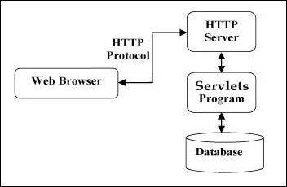
Servlets Architecture (Diagram)

Slide 5
Servlet Tasks
Read the explicit data sent by the clients (browsers). This includes an HTML form on a Web page, or it could also come from an applet or a custom HTTP client program.
Read the implicit HTTP request data sent by the clients (browsers). This includes cookies, media types and compression schemes the browser understands, and so forth.
Process the data and generate the results. This process may require talking to a database, executing an RMI or CORBA call, invoking a Web service, or computing the response directly.
Send the explicit data (i.e., the document) to the clients (browsers). This document can be sent in a variety of formats, including text (HTML or XML), binary (GIF images), Excel, etc.
Send the implicit HTTP response to the clients (browsers). This includes telling the browsers or other clients what type of document is being returned (e.g., HTML), setting cookies and caching parameters, and other such tasks.

Slide 6
Servlet Packages
Java Servlets are classes run by a web server that has an interpreter that supports the Java Servlet specification.
Servlets can be created using the javax.servlet and jax.servlet.http packages, which are a standard part of the Java’s enterprise edition, an expanded version of the Java class library that supports large-scale development projects.
These classes implement the Java Servlet and JSP specifications. Java servlets have been created and compiled just like any other Java class. After you install the servlet packages and add them to your computer’s Classpath, you can compile servlets with the JDK’s Java compiler or any other current compiler.

Slide 7
Servlets – Life Cycle
A servlet life cycle can be defined as the entire process from tis creation till the destruction. The following are the paths followed by a servlet.
The servlet is initialized by calling the init() method.
The servlet calls service() method to the process a client’s request.
The servlet is terminated by calling the destroy() method.
Finally, servlet is garbage collected by the garbage collector of the JVM.

Slide 8
The Init() Method
The init method is called only once. It is called only when the servlet is created, and not called for any user requests afterwards. So, it is used for one-time initializations, just as with the init method of applets.
The servlet is normally created when a user first invokes a URL corresponding to the servlet, but you can also specify that the servlet be loaded when the server is first started.
When a user invokes a servlet, a single instance of each servlet gets created, with each user request resulting in a new thread that is handed off to doGet or doPost as appropriate. The init() method simply creates or loads some data that will be used throughout the life of the servlet.
The init method definition looks like this:
public void init() throws ServletException {
// Initialization code...
}

Slide 9
The Service() Method
The service() method is the main method to perform the actual task. The servlet container (i.e. web server) calls the service() method to handle requests coming from the client (browsers) and to write the formatted response back to the client.
Each time the server receives a request for a servlet, the server spawns a new thread and calls service. The service() method checks the HTTP request type (GET, POST, PUT, DELETE, etc.) and calls doGet, doPost, doPut, doDelete, etc. methods as appropriate.
Here is the signature of this method:
public void service(ServletRequest request, ServletResponse response)
throws ServletException, IOException {
}

Slide 10
The Service() Method (Continued)
The service() method is called by the container and service method invokes doGet, doPost, doPut, doDelete, etc. methods as appropriate. So you have nothing to do with the service() method, but you override either doGet() or doPost() depending on what type of request you receive from the client.
The doGet() and doPost() are most frequently used methods with in each service request.

Slide 11
The doGet() Method
A GET request results from a normal request for a URL from an HTML form that has no METHOD specified and it should be handled by doGet() method.
public void doGet(HttpServletRequest request, HttpServletResponse response)
throws ServletException, IOException {
// Servlet code
}

Slide 12
The doPost() Method
A POST request results from an HTML form that specifically lists POST as the METHOD and it should be handled by doPost() method.
public void doPost(HttpServletRequest request, HttpServletResponse response)
throws ServletException, IOException {
// Servlet code
}

Slide 13
The destroy() Method
The destroy() method is called only once at the end of the lice cycle of a servlet. This method gives your servlet a chance to close database connections, halt background threads, write cookie lists or hit counts to disk, and perform other such cleanup activities.
After the destroy() method is called, the servlet object is marked for garbage collection. The destroy method definition looks like this:
public void destroy() {
// Finalization code...
}

Slide 14
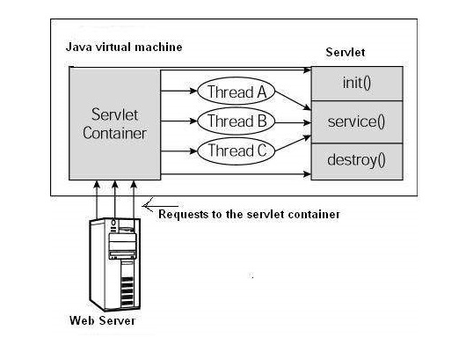
Life Cycle (Architectural Diagram)
First the HTTP requests coming to the server are delegated to the servlet container.
The servlet container loads the servlet before invoking the service() method.
Then the servlet container handles multiple requests by spawning multiple threads, each thread executing the service() method of a single instance of the servlet.

Slide 15
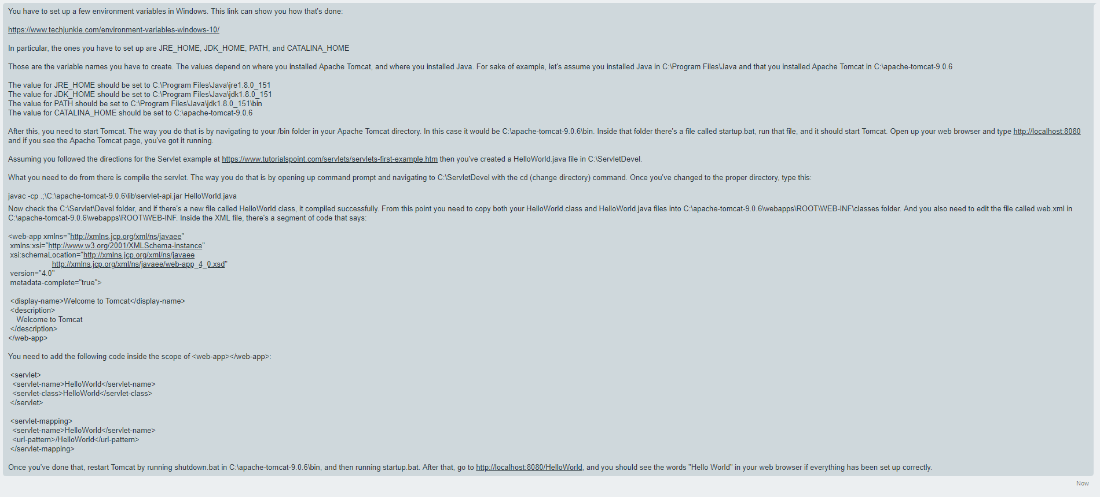
Setting Up Apache Tomcat & Compiling Your First Servlet

Slide 16
Title and Content Layout with Chart

Slide 17
Two Content Layout with Table
First bullet point here
Second bullet point here
Third bullet point here
Class | Group A | Group B
Class 1 | 82 | 95
Class 2 | 76 | 88
Class 3 | 84 | 90

Slide 18
Two Content Layout with SmartArt
Group A
Task 1
Task 2
Group B
Task 1
Task 2
Task 3
First bullet point here
Second bullet point here
Third bullet point here

Slide 19
Add a Slide Title - 1

Slide 20
Add a Slide Title - 2

Slide 21
Add a Slide Title - 3

Slide 23
Add a Slide Title - 4

Slide 24
Add a Slide Title - 5

Slide 25
Add a Slide Title - 6

